Slide 1
Welcome to C4C: Coding for Conservation!
June 2022 – March 2023

Slide 2

Thanks to our sponsors!

Slide 3
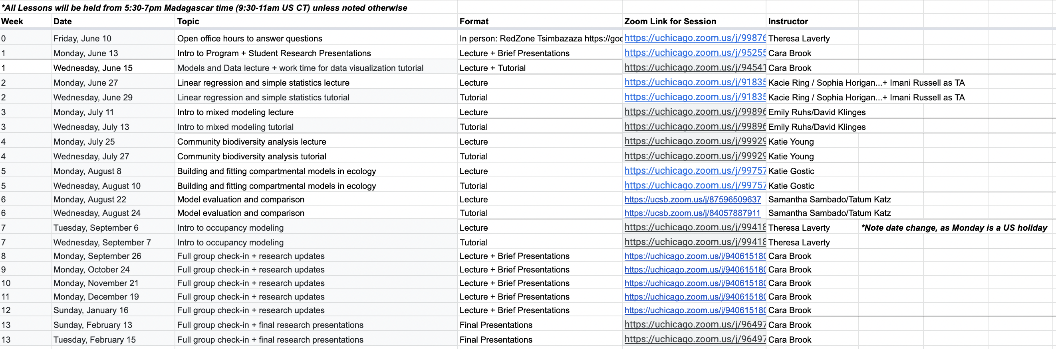
Course Syllabus
https://docs.google.com/spreadsheets/d/1NxoWXWjJQMAHUbshYlE9oUVd0FoKkl1ux2dw5pfOf2M/edit#gid=0

Slide 4
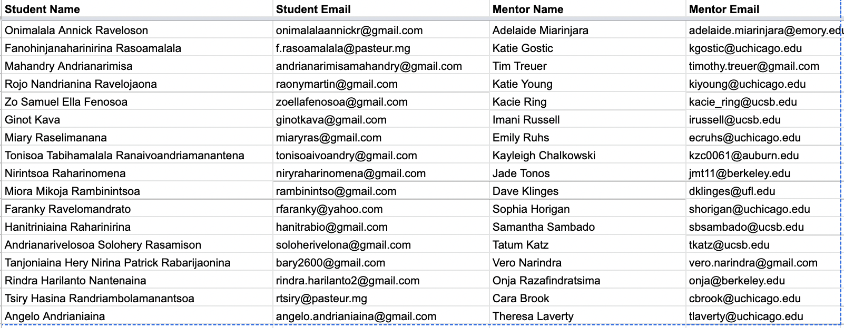
Mentors

Slide 5
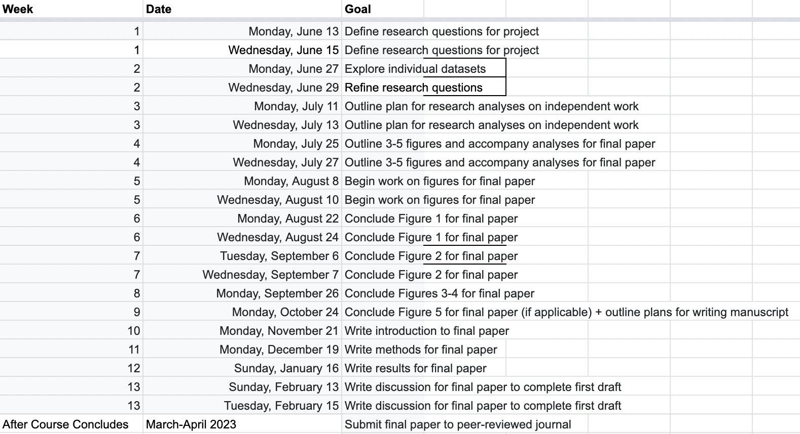
Mentor – Student Goals

Slide 6
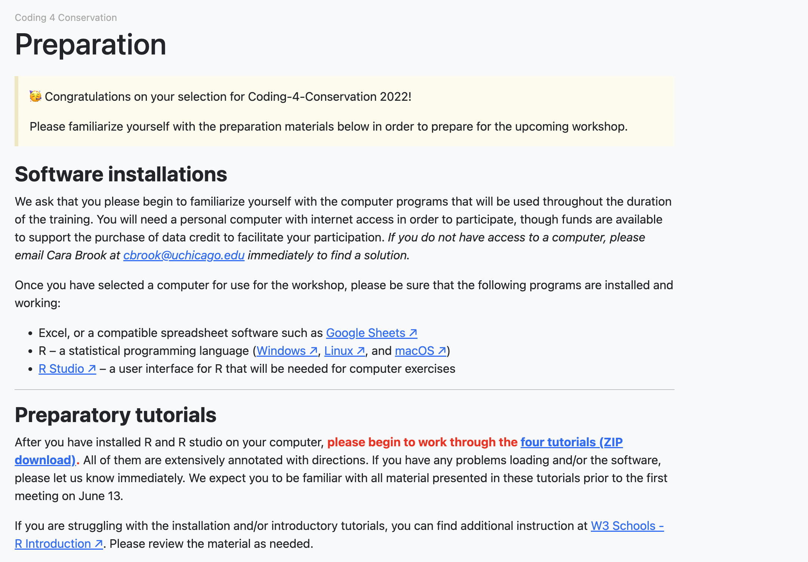
Preparation
https://coding4conservation.org/preparation

Slide 7
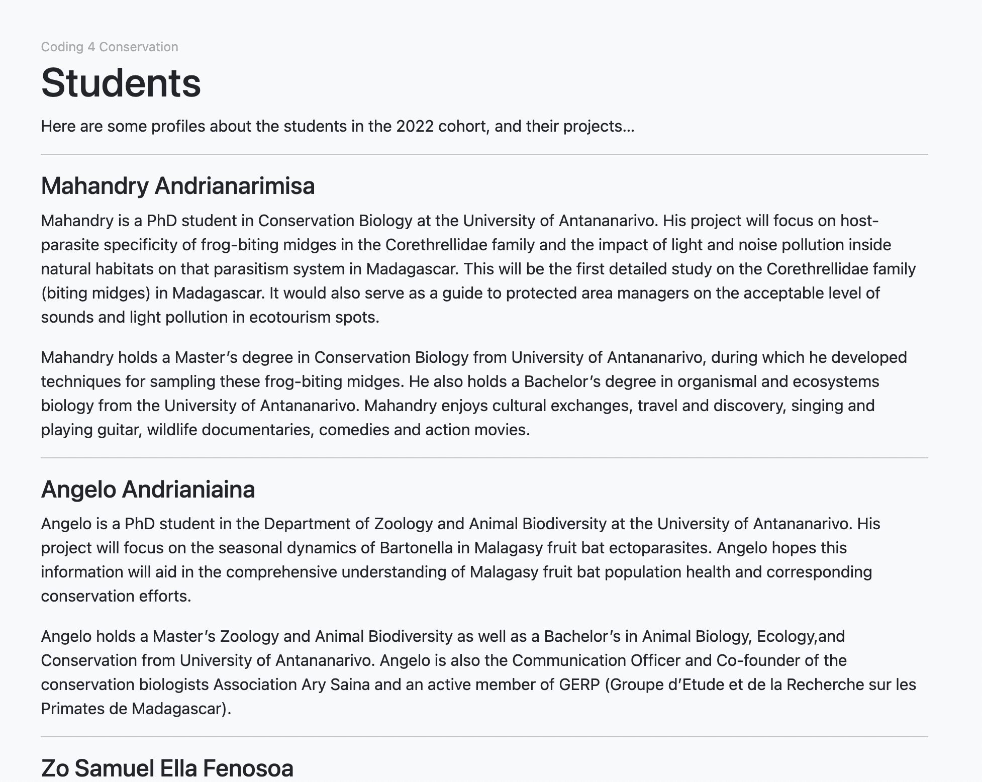
Student Profiles
https://coding4conservation.org/students
https://airtable.com/shrULfcw3tiT5UeYX

Slide 8
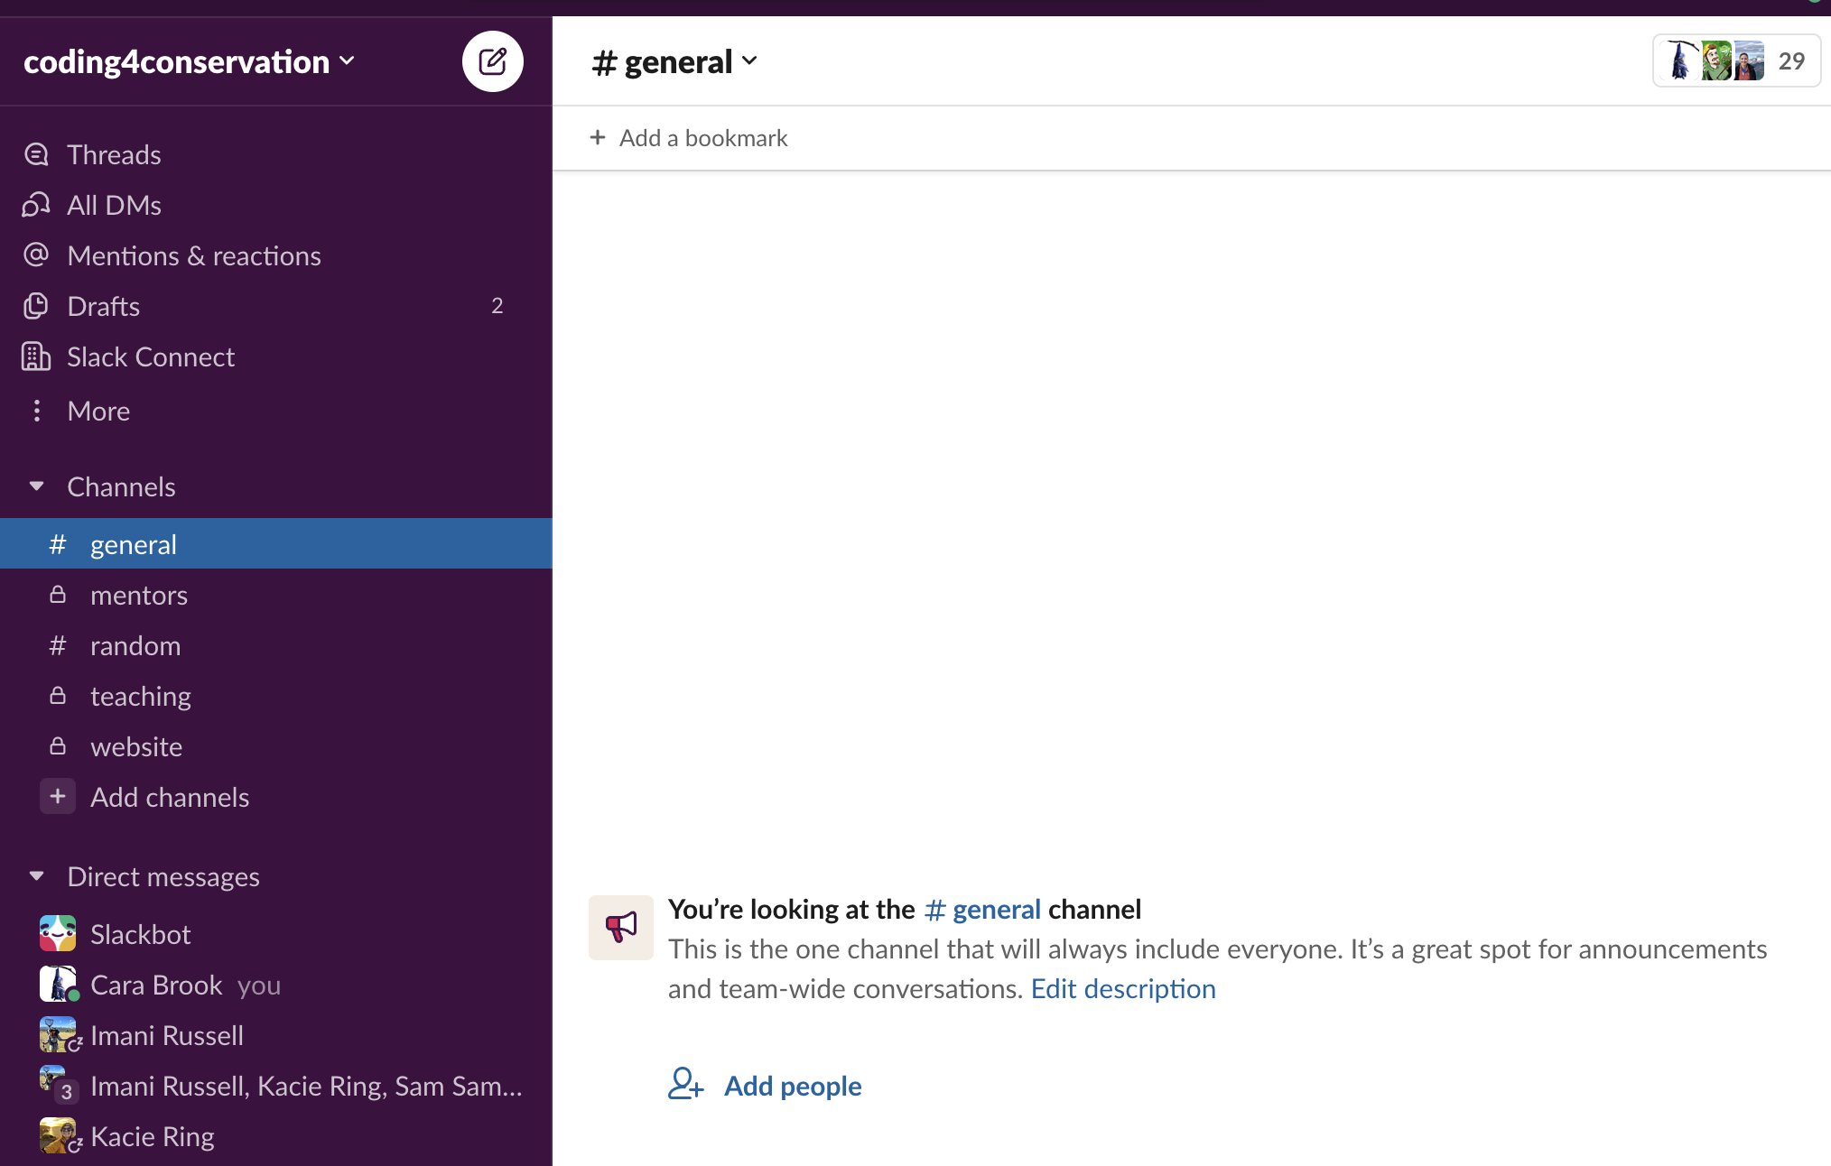
Join the Slack!
https://join.slack.com/t/coding4conservation/shared_invite/zt-1abg2m0jo-LXqO4fXkS3qXz~sy2Mpfow

Slide 9
Data Needs
Survey indicated a preference for mobile money and data to take calls from home
We can provide 20,000Ar/week/student x 13 scheduled weeks with zoom.
We can provide scratch cards in advance or reimburse your own data purchases if receipts are provided.
We will keep tabs on data needs and have some budget to increase this, especially in the later months of the course if needed.

Slide 10
Misaotra!

